Slide 1
Welcome

Slide 2
Presentation Topic: Blanking and Synchronizing Pulses
Presented To:
Name: Md. Imran Hossain
Assistant professor
Department of ICT
Comilla University
Presented by:
Name: Priyosree Sana
ID No: 11809039
Department of ICT
Comilla University

Slide 3
Outline:
Introduction.
Blanking Pulses.
Horizontal blanking pulses
Vertical blanking pulses
Synchronizing pulses.
Horizontal Synchronizing pulses
Vertical Synchronizing pulses
Importance of blanking and synchronizing pulses.

Slide 4
Introduction:
A positive or negative square-wave pulse used to switch off a part of a television or radar set electronically for a predetermined length of time ,is called blanking pulse.
The process in which the signals are transmitted and received in accordance with the clock pulses, is called synchronizing pulse.
Blanking pulses to make the retrace invisible and synchronizing pulses to synchronize the transmitter and receiver scanning.

Slide 5
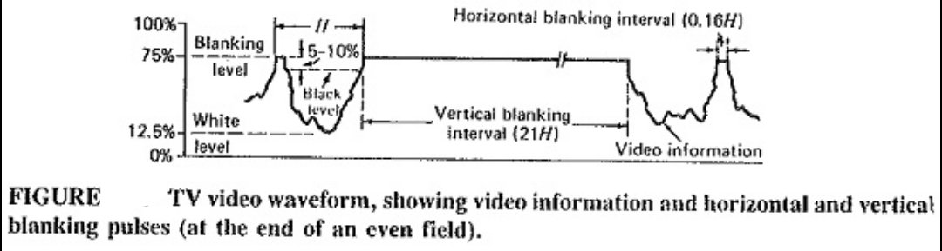
---Blanking Pulses---

Slide 6
----Continued----
In television, “Blanking” means going to black. As part of the video signal, blanking voltage is at the black level. Video voltage at the black level cuts off beam current in the picture tube to blank out line from the screen.
In the figure, the white level corresponds to 12.5% modulation of the carrier and the black level corresponds to 67.5% modulation.
In this figure, blanking level corresponds to 75% of maximum modulation. The black level is actually defined relatively rather than absolutely. It is 5 to 10 percent below this. Approximately 67.5% as previously stated.
At last, we thus have white at 1.25V, black at about 6.75V and the blanking level at 7.5V
The difference between the blanking level and the black lavel is known as the setup interval.

Slide 7
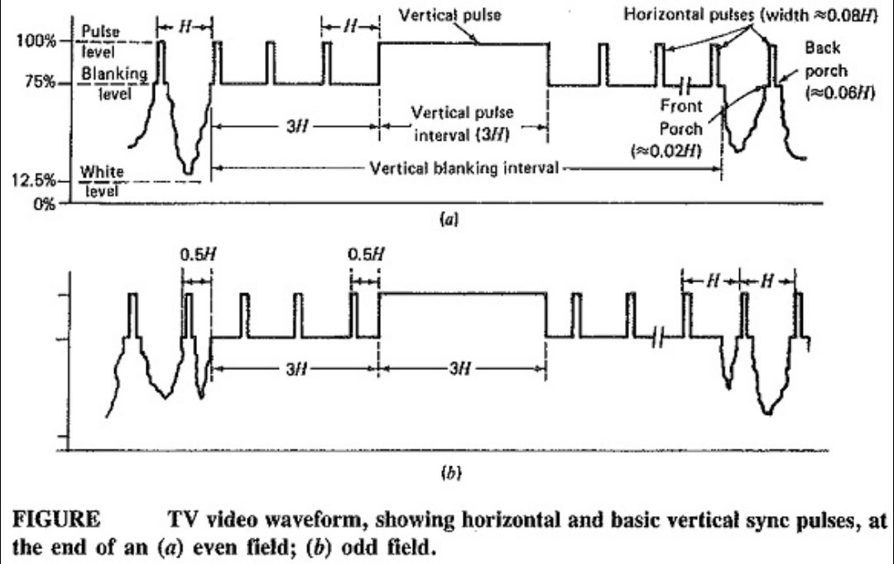
Synchronizing pulses

Slide 8
----Continued----
The procedure for inserting synchronizing pulses is fundamentally the same as used in blanking pulse insertion.
Horizontal and vertical pulses are added appropriately on top of the blanking pulses. It is seen that the tips of horizontal and vertical synchronizing pulses reach at level that corresponds to 100% modulation of the picture carrier. Here, we may thus have video between 1.25 and 6.75V, the blanking level at 7.5V and the sync pulse tips at 10V.
In the Figure (a), after the start of the vertical blanking period, the leading edges of the three horizontal sync pulses and the vertical sync pulse shown will trigger the horizontal oscillator in the receiver. There are no leading edges for a time of 3H after that, as shown.

Slide 9
----Continued----
In the Figure (b), the vertical blanking period at the end of an odd field begins midway through a horizontal line. Looking further along this waveform, we see that the leading edge of the vertical sync pulse comes at the wrong time to provide synchronization for the horizontal oscillator.
Importance of blanking and synchronizing pulses:
The purpose of the blanking pulse is to make invisible the re-traces required in scanning. And the synchronizing pulses are transmitted or stored along with the analog video signal for each line.

Slide 10
Thank You

